Slide 1
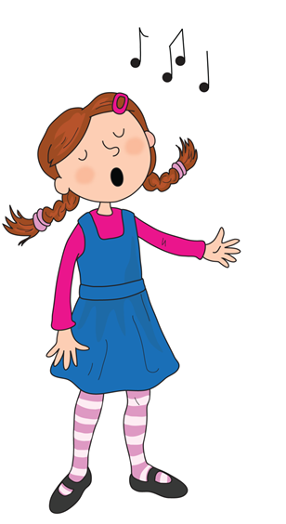
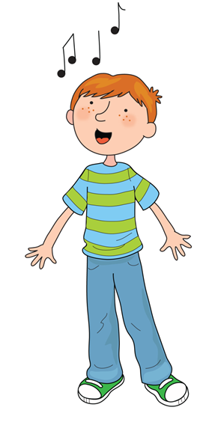
Song of Sounds

Slide 2

Song of Sounds

Slide 3

We can sing a song of sounds, skip to my lou my darling

Slide 4

Ants on an apple a a a

Slide 5

Butterflies are beautiful b b b

Slide 6

Caterpillars coughing c c c

Slide 7
Skip to my lou my darling

Slide 8

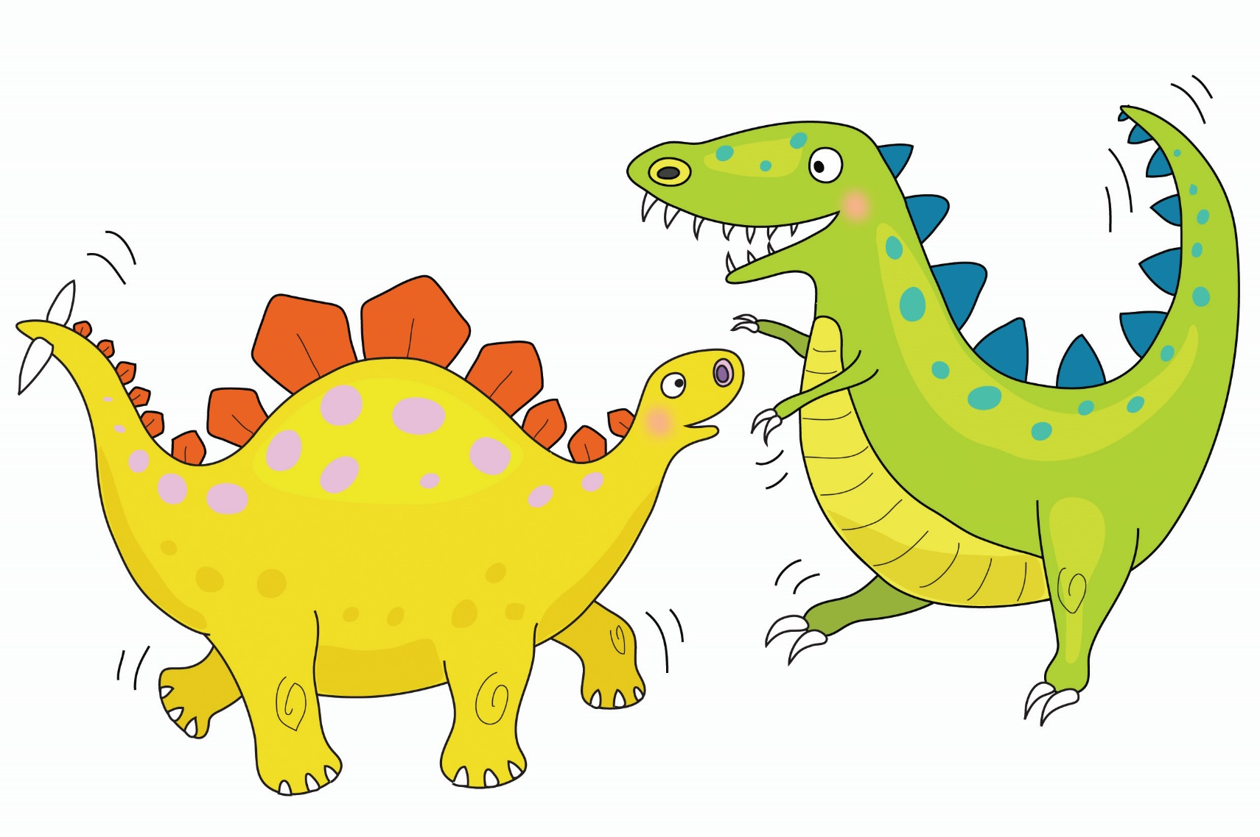
Dinosaurs are dancing d d d

Slide 9
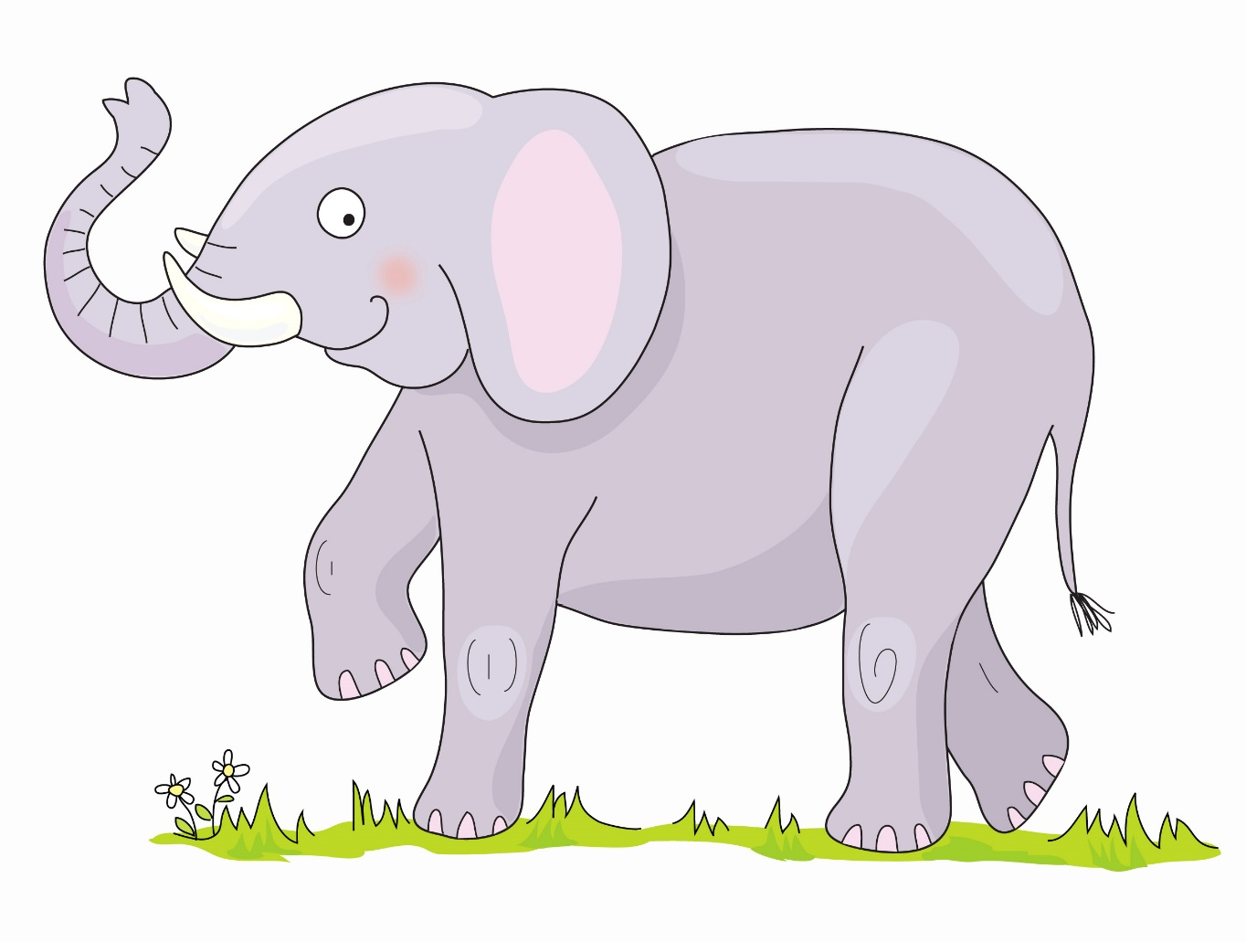

Elephant’s enormous e e e

Slide 10

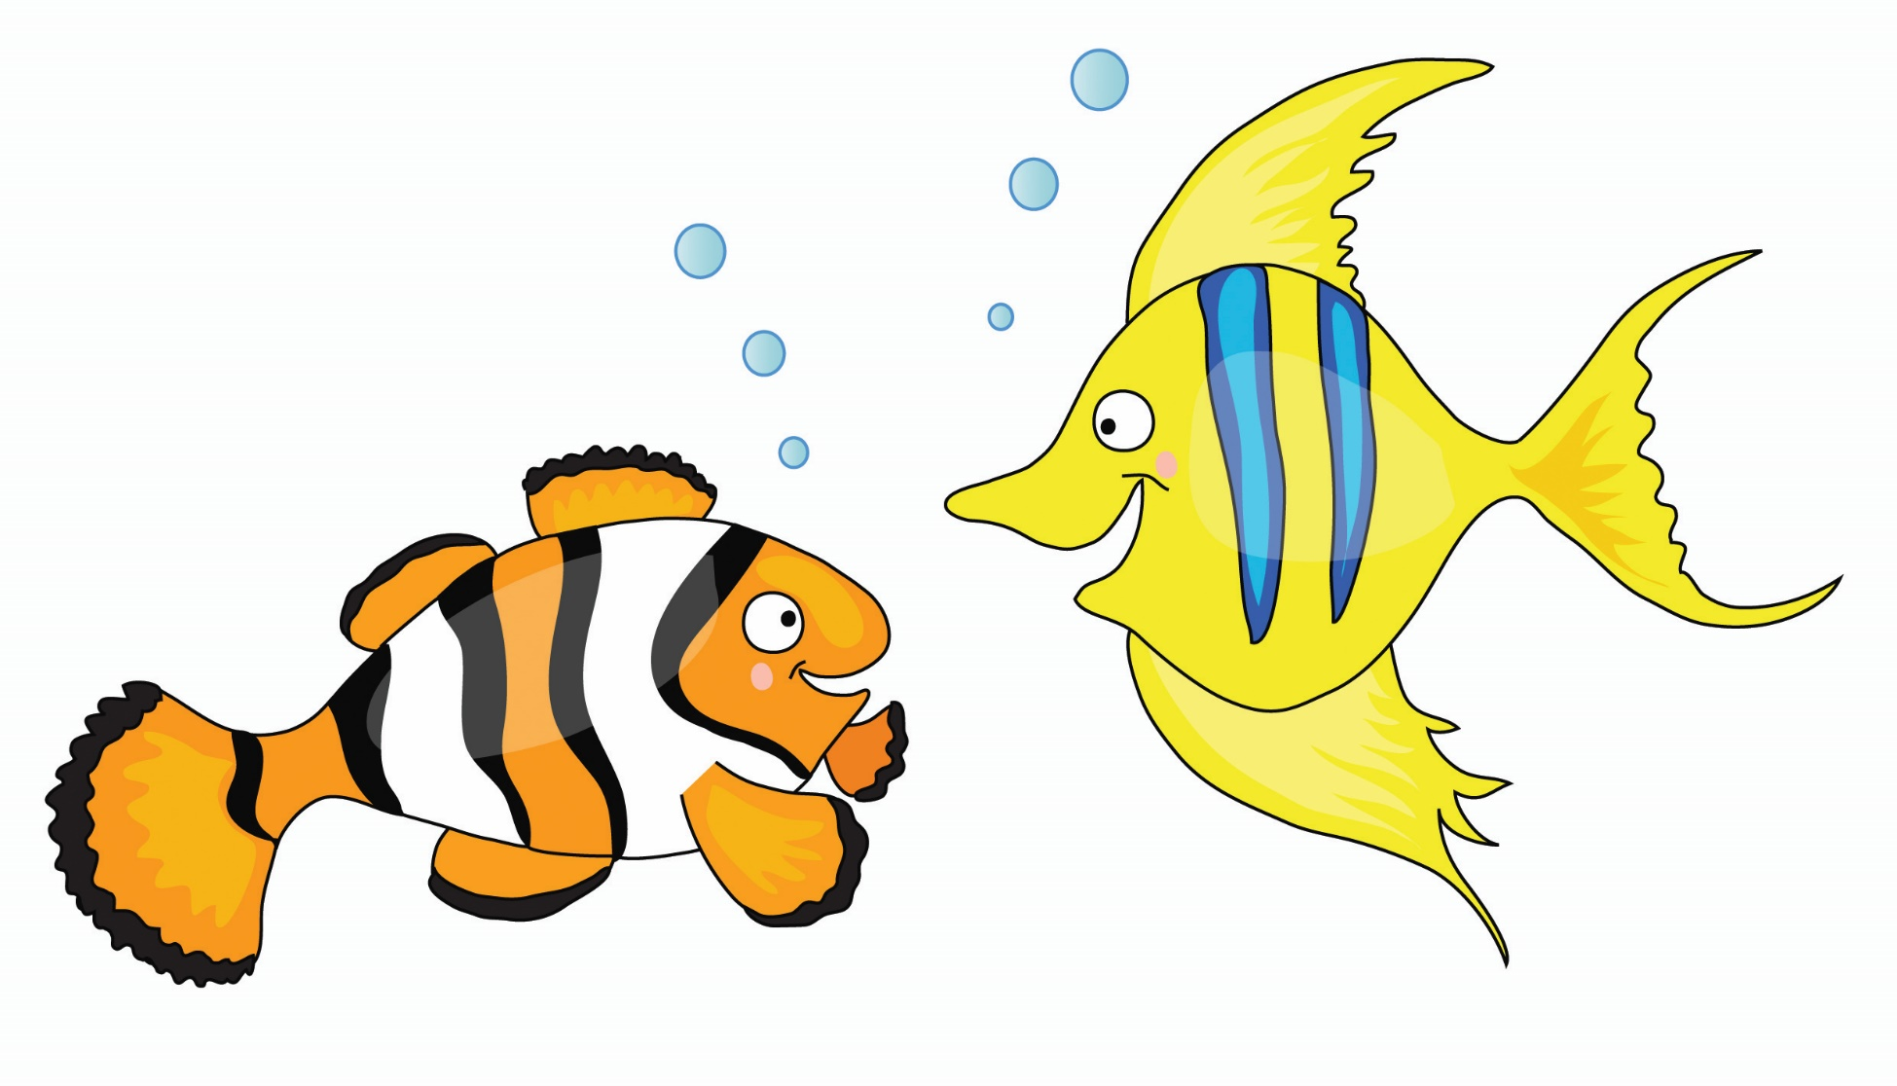
Fish are funny f f f

Slide 11
Skip to my lou my darling

Slide 12

Goats are gardening g g g

Slide 13

Hats on heads h h h

Slide 14

Insects are interesting i i i

Slide 15
Skip to my lou my darling

Slide 16

Jellybeans are jumping j j j

Slide 17

Kings flying kites k k k

Slide 18

Lions love lollipops l l l

Slide 19
Skip to my lou my darling

Slide 20

Mice are munching m m m

Slide 21

Nurse Nelly’s nice n n n

Slide 22

Octopus is orange o o o

Slide 23
Skip to my lou my darling

Slide 24

Popcorn popping p p p

Slide 25


Queens run quickly qu qu qu

Slide 26

Rabbits are rascals r r r

Slide 27
Skip to my lou my darling

Slide 28

Sausages are sizzling s s s

Slide 29

Tiger on the TV t t t

Slide 30
Umbrellas up u u u

Slide 31
Skip to my lou my darling

Slide 32

Val has a violin v v v

Slide 33

Whales in the water w w w

Slide 34

Fox on a box x x x

Slide 35
Skip to my lou my darling

Slide 36

Yellow yoyo y y y

Slide 37

Zebras in the zoo z z z

Slide 38
Sing a song ng ng ng

Slide 39
Skip to my lou my darling

Slide 40
Sharks on the shore sh sh sh

Slide 41
Chickens eating cheese ch ch ch

Slide 42
Thorn in my thumb th th th

Slide 43
Skip to my lou my darling

Slide 44
Train in the rain ai ai ai

Slide 45
Busy busy bee ee ee ee

Slide 46
Soar up high igh igh igh

Slide 47
Skip to my lou my darling

Slide 48
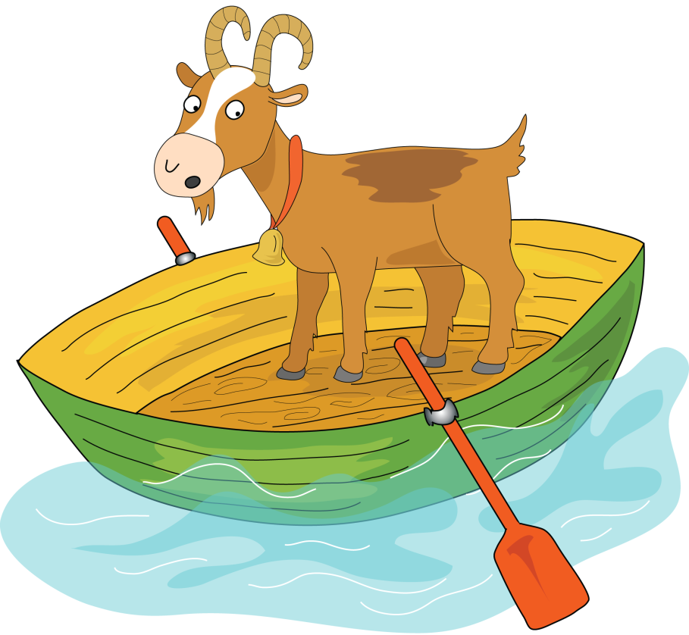

Goat on a boat oa oa oa

Slide 49
Zoom to the moon oo oo oo

Slide 50
Look in a book oo oo oo

Slide 51
Skip to my lou my darling

Slide 52
Go far in your car ar ar ar

Slide 53
It’s a horse of course or or or

Slide 54
Flower in a shower er er er

Slide 55
  Skip to my lou my darling

Slide 56

Don’t be noisy oi oi oi

Slide 57
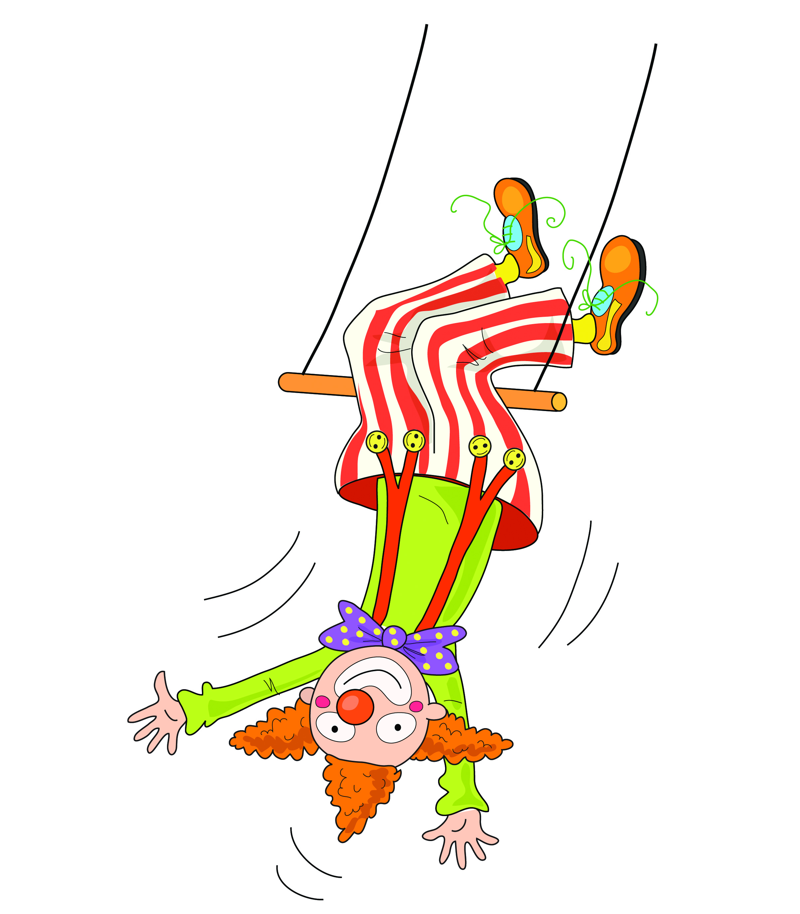

Clown upside down ow ow ow

Slide 58
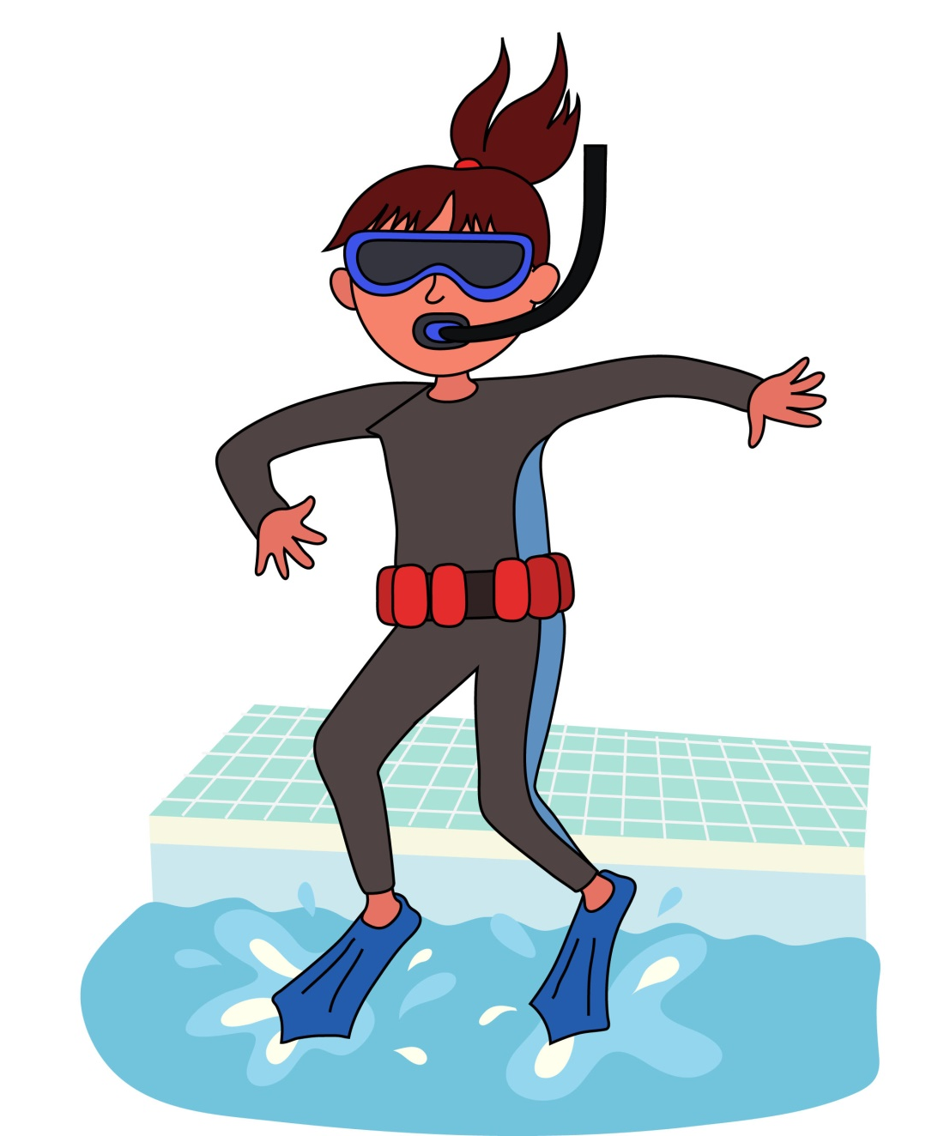
I think I will sink nk nk nk

Slide 59
  Skip to my lou my darling

Slide 60
Hairy fairy air air air

Slide 61
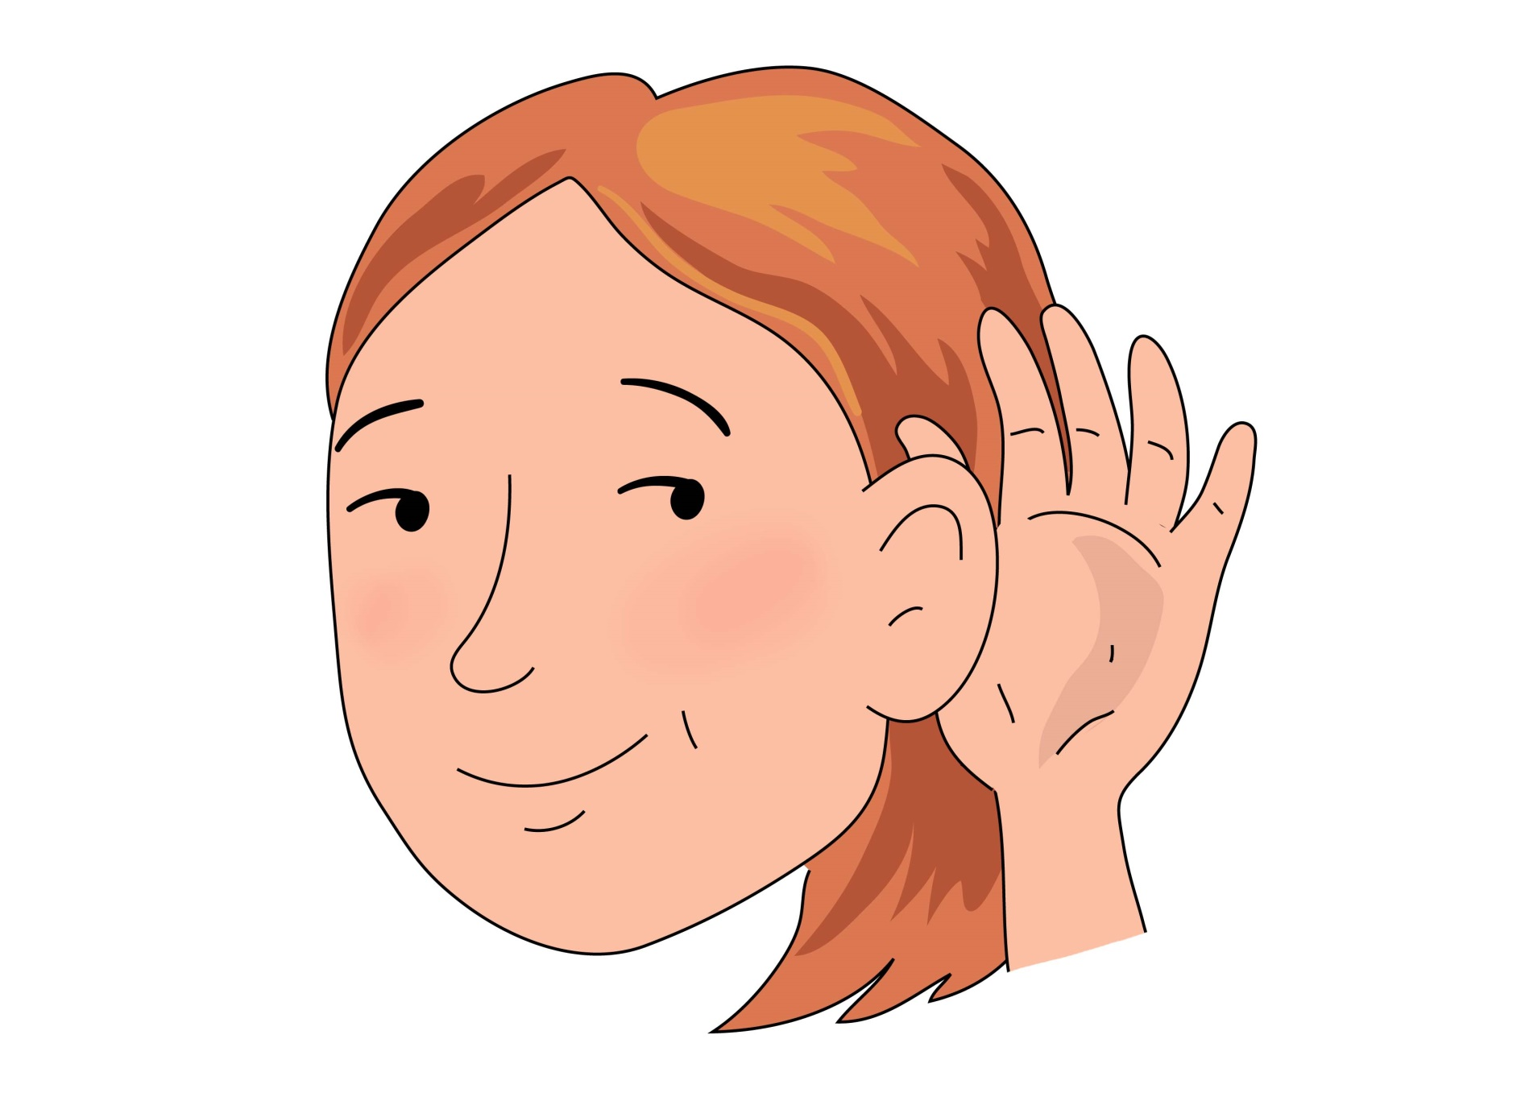

Hear with your ear
ear ear ear

Slide 62
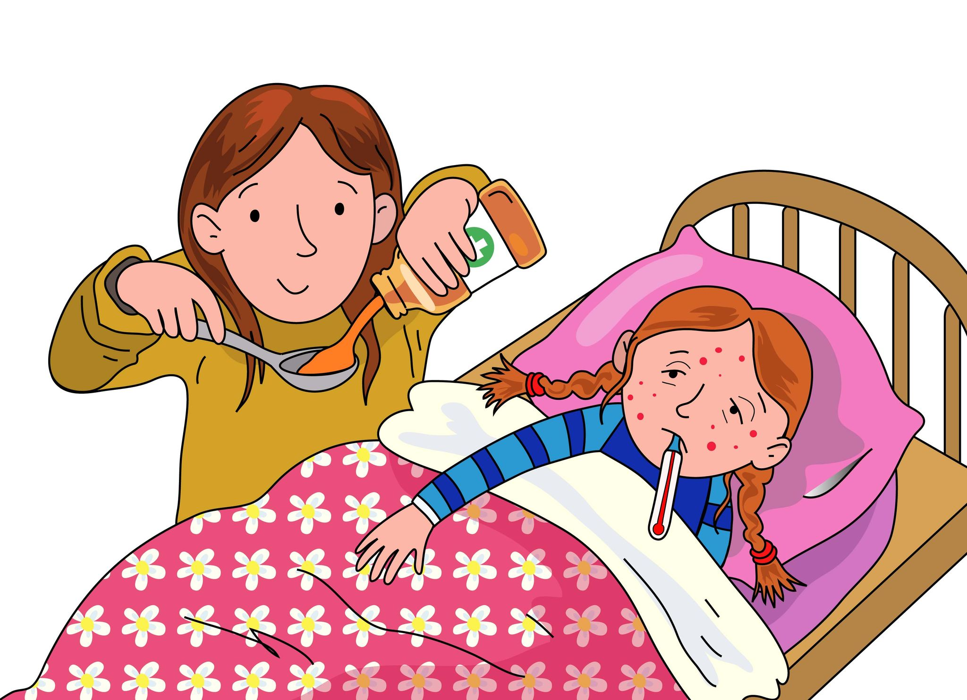

I’m sure there’s a cure ure ure ure

Slide 63
Skip to my lou my darling

Slide 64
Now we’ve sung our song to you, you can learn to blend sounds too.

Slide 65
Blending helps you read and write so sing this song all day and night.

