Slide 1

Reception Induction
September 2024

Slide 2
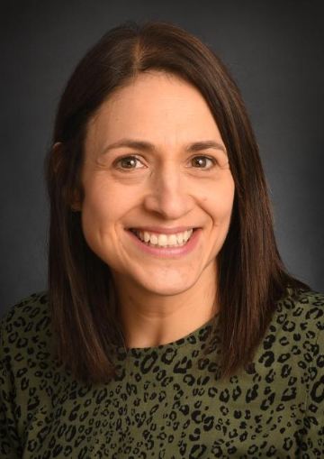

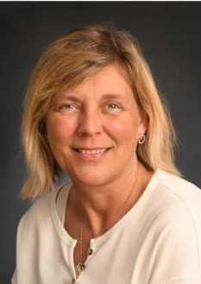
Meet the team
Mrs Gott Miss Hanton Mrs Bowen
Class Teacher EYFS Lead – Class Teacher Teaching Assistant
2 Days (Mon/Tues) 3 Days (Wed/Thurs/Fri) 5 Days corkill.h@welearn365.com hanton.c@welearn365.com

Slide 3

The Foundation Stage in Reception
What we’re all about…
The unique child: we observe each child’s development, assess and plan for their next steps, identify any need for additional support and most importantly keep them safe
Adults role: we aim to be caring and sensitive towards each child, support their independence, set boundaries and help them to move on in their learning
Characteristics of effective learning: we encourage learning through, playing and exploring, active learning (being involved and motivated) and thinking of their own ideas and ways to do things
The 7 areas of Learning and Development
The Prime Areas
  Personal, Social and Emotional Development
  Communication and Language
  Physical Development
The Specific Areas
  4. Literacy
  Maths
  Understanding the World
  Expressive Arts and Design
Our main focus in the autumn term will be the prime areas within which children need to be secure before moving onto anything else.

Slide 4
EYFS for Parents
For more details on the new EYFS statutory Framework 2021 follow the link
https://assets.publishing.service.gov.uk/government/uploads/system/uploads/attachment_data/file/974907/EYFS_framework_-_March_2021.pdf

Slide 5
The Importance of Play
“Play is essential for children’s development, building their confidence as they learn to explore, relate to others, set their own goals and solve problems.” EYFS 2021
We ensure children have daily opportunities for sustained periods of play with adult support as we believe that during play children will learn
to become more confident and independent, make their own choices and access resources
to be interested and fully engaged when they have chosen their own activity as this is likely to lead to focused learning
to be good communicators, to listen to others, to increase their understanding and their range of vocabulary.
to be curious and make sense of the world through exploring, experimenting and questioning
to grow in resilience as they practice and build upon ideas and skills, to solve problems
to be creative thinkers and use their imagination and skills in new situations
to be empathic as they learn about relating to others and make new friends
to be self regulating, learn about boundaries, communicate effectively to negotiate with others and learn about the need for rules
To learn specific skills like Maths and English which are interwoven within play such as: writing messages, counting bricks, measuring heights, measuring amounts, fitting pieces together, reading text (stories, recipes, instructions) keeping scores, writing signs
That’s a lot of skills involved in ‘just playing’!

Slide 6
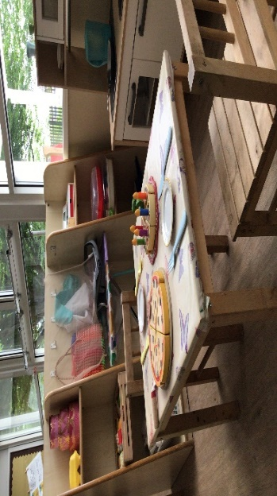
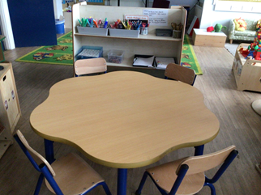
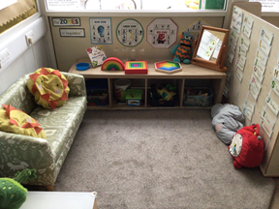
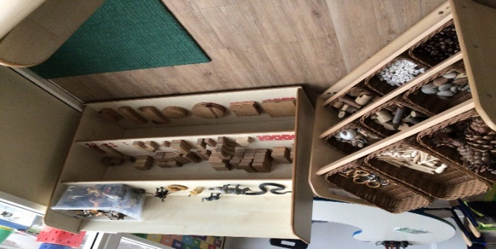
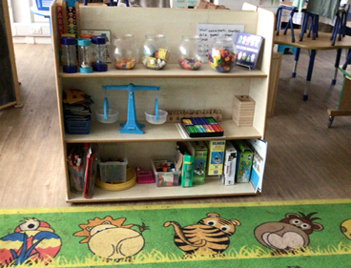
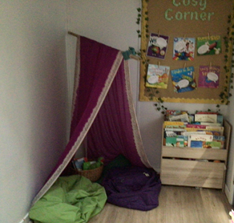
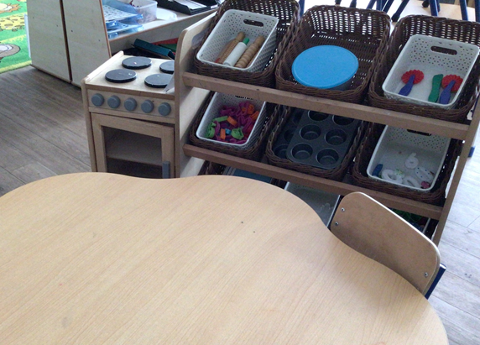
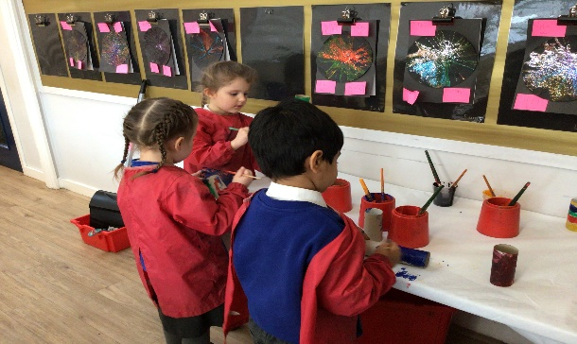
The Classroom
An enabling environment within which we support learning through carefully thought out and selected resources. The classroom is set up to enable the children to engage in independent, active, sustained learning through play. The resources are enhanced (added to) to develop our theme and according to the current children’s interests.
Messaging centre
Sensory area
Story world
Home Corner
Maths shelves
Playdough
Workshop
Cosy corner

Slide 7
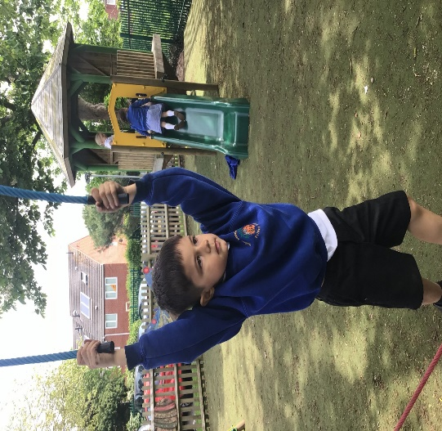
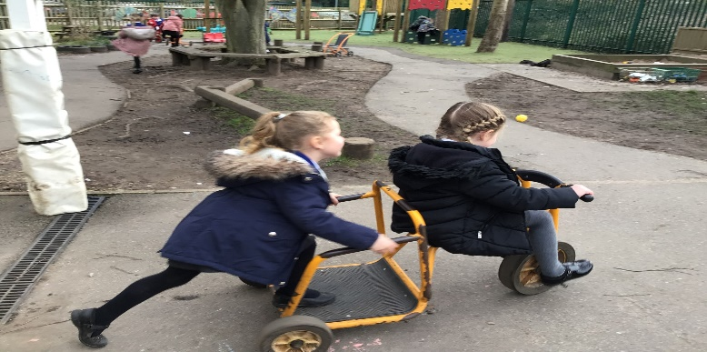
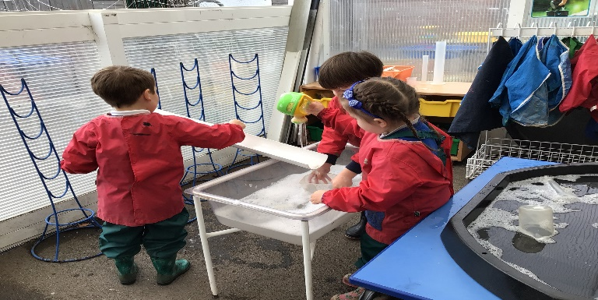
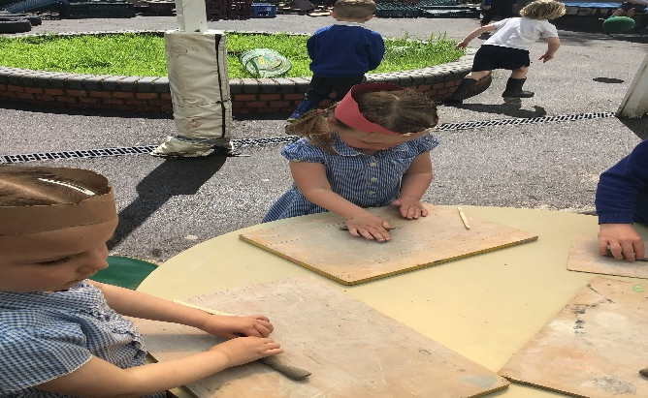
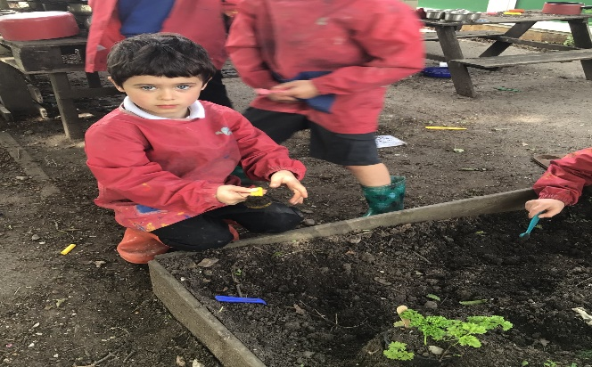
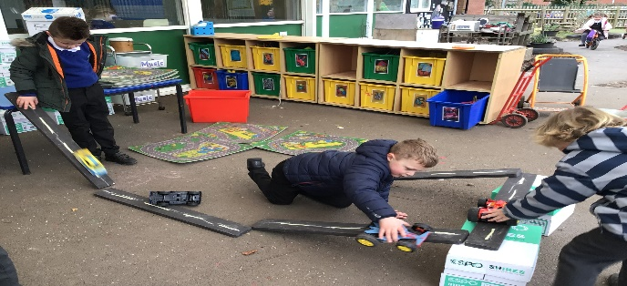
Outside
The outdoor area allows the children to be more active physical learners. We have a range of open ended resources for the children to explore which have been developed to promote all areas of learning and are adapted to meet the current children’s needs and interests
The tree house and swinging trail
Biking
Water world
Marvellous muddy kitchen

Slide 8
Assessment Information
Each child will have a learning journal. In here we put teacher led activities together with independent work and observations which all build a picture of your child’s learning and progress over the year.
We also use an online learning journal system which allows us to share observations with you and enables you to share observations with us too. More information will be given in September – including your log in details.
Parents Evening (In Autumn and Spring term) will be an opportunity to discuss how your child is progressing, any concerns you may have and ways you can help.
Currently we are required to assess children at the beginning of the academic year using the Reception Baseline Assessment. The results of this are not published, they are used by the government to track progress from entry into school up to Y6. https://www.gov.uk/guidance/reception-baseline-assessment At the end of the reception year we assess against statements called Early Learning Goals. Your child’s results will be included with the end of year report. The Early Learning goals can be found within the EYFS statutory framework.

Slide 9
Our Induction Programme
Wednesday 10th July
Stay and Play session in school
Week commencing 2nd September
Home visits – 3rd-6th September
Week commencing 9th September
Mornings plus lunch – all children in school 8.40am–1pm
You will be given a time that your child should arrive on Monday 9th September
Week commencing 16th September
All children in school full time

Slide 10
The School Day
8.40am The children come in through the gates at the front of school next to the main entrance and office to organise their coats and bags
8.50am Children should be in the classroom and the school day begins with the morning and dinner registers
9.00-11.50am Morning sessions usually consist of an English, Phonics and Maths teacher led input followed by small group work and supported play in the continuous provision
10.20-10.35am Snack time
12.00 – 1.15pm Lunchtime (hot dinners or sandwiches)
Reception children eat first and then go out to play in the Reception play area. We may move to playing in the big playground as the year progresses.
1.15pm –Afternoons may have a teacher led skill (art, understanding the world, music personal and social or physical skills). Individual reading and adult supported play in continuous provision.
3.15pm School ends – collect your child from outside the Reception gate. Children should be available to pick up by 3.15pm to enable parents to get to the main playground by 3.20pm to pick up siblings. It is important that you let us know if someone new is picking your child up otherwise we may not let them go.

Slide 11
Lunchtime
All children in Reception (and KS1) are entitled to a free school meal
Our lunches are provided by Educaterers. Information about them and sample menus can be found here: https://educaterers.co.uk/our-menus
We operate a colour band system:
Red – meat option Green – vegetarian option Brown – jacket potato with either cheese, baked beans or tuna
There are special menus for children with allergies and specific dietary requirements. These children are given a Purple band to wear too.
The children will make their choice during morning registration and will be given a colour band just before lunchtime. It is helpful to look at the menu with your child each day so that they are ready to make their choice when they arrive at school.
The children are served their lunch on a plate with different compartments for main meal, pudding, drink and cutlery. The children check with a grown up to make sure it is ok to eat their pudding. This allows us to keep an eye on what they’re eating.
The Reception teaching staff will stay with the children at lunchtime for as long as necessary whilst the children become familiar with the school routine and as the lunchtime staff get to know them.

Slide 12
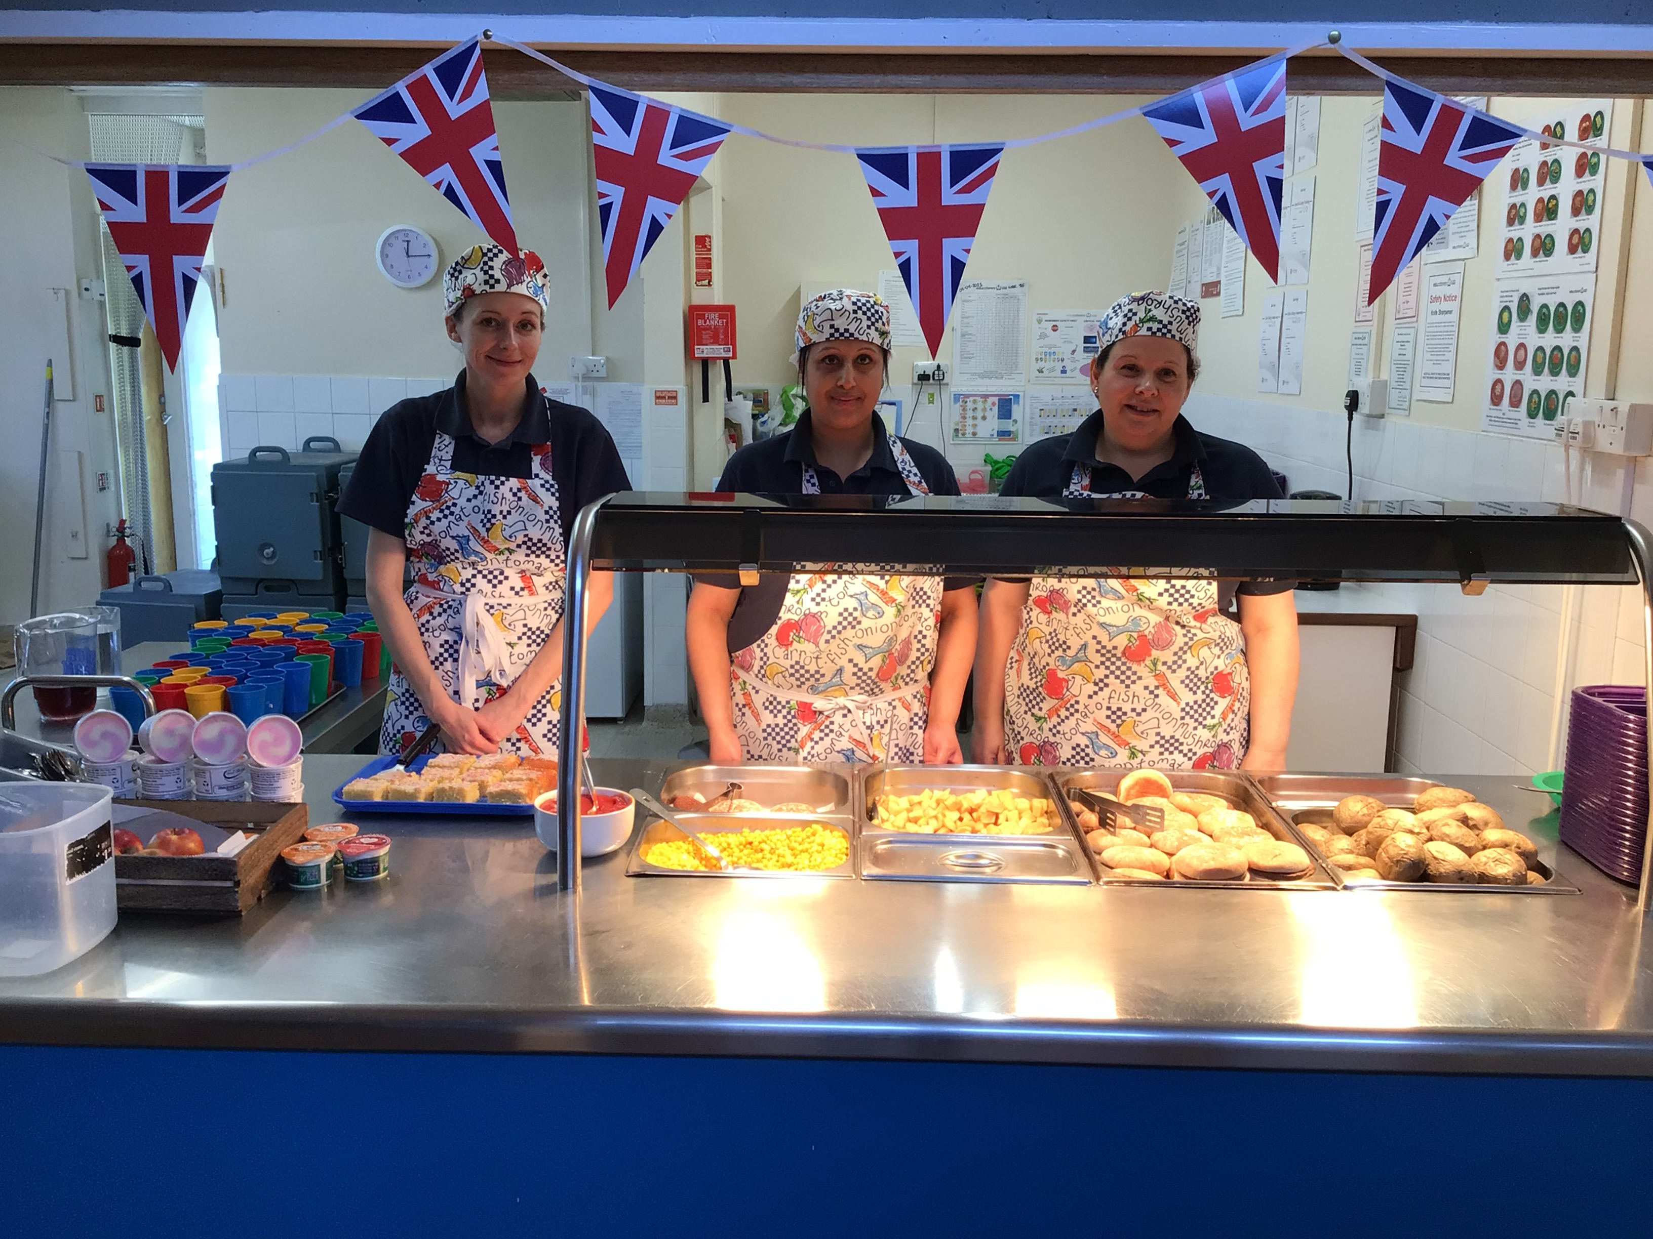
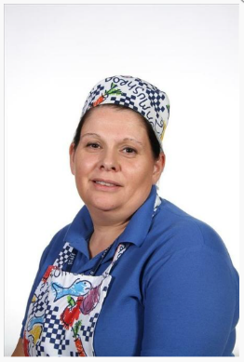
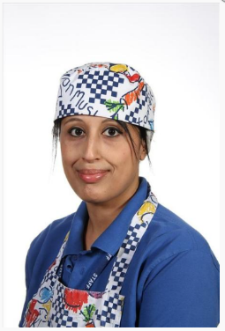
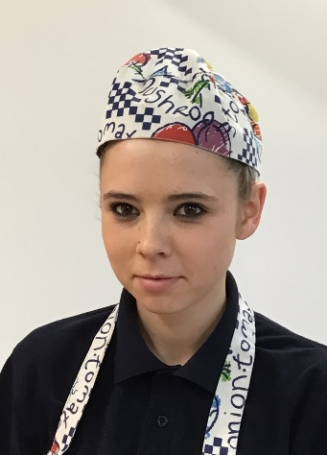
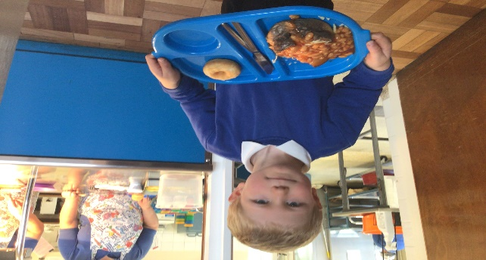
Lunchtime…
The majority of children in Reception have a school meal – you’ll be surprised at what they eat here!
You can choose to send your child with a packed lunch and can also mix and match between school meals and packed lunches over the course of a week. If you have any concerns about your child having a school meal please look at the menu with them and choose some meals that you know they like. This can be a good way to start.
Mrs Dixon Mrs Ruprah Miss Bartlett

Slide 13
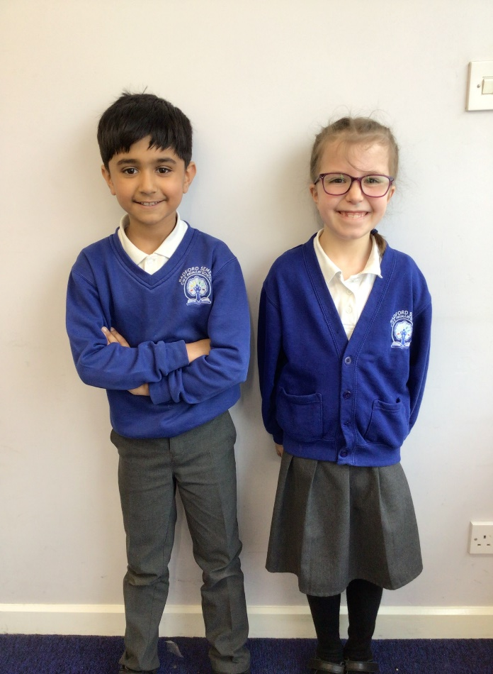
What do they need…
School Uniform
All children wear the following uniform:
White polo shirt
Royal blue jumper or cardigan (jumpers and cardigans with school logo are available but children are also allowed to wear plain royal blue jumpers and cardigans)
Dark grey or black school trousers, shorts, skirt (knee-length) or pinafore dress
Blue and white checked dresses may be worn in the Summer term
Grey or black socks (white in Summer) or grey or black tights
Plain black school shoes (no trainers or boots)
Long hair tied back using discreet hair accessories
Small stud earrings and a small watch may be worn but no other jewellery is permitted
Please see link for details of ordering logo items
https://www.schoolshopsales.com/radfordsemeleprimary/

Slide 14
What do they need…
Suitable outdoor clothes (we try to go outside whatever the weather) – Warm coat, hat, gloves, raincoat, sunhat, sun cream (depending on the weather). We have plenty of wellies in school for the children to use.
A school book bag – to keep their reading books, reading diary, sound books and letters safe
A change of clothes (pants, socks/tights trousers/tracksuit bottoms/skirt) to keep on their peg in case of an accident
A water bottle
A healthy snack – school will provide a piece of fruit each morning, but you are welcome to send in a healthy snack too e.g. breadsticks, cheese and crackers, rice cakes, raisins etc…
Please make sure everything is labelled - including shoes!

Slide 15
PE Kit
You will not need to send a PE kit into school until the Summer term.
We will start PE lessons after Christmas but won’t get changed into PE kits until later in the year. These will then stay in school, and we will send them home at the end of each half term.
Children wear the following for PE:
Indoor PE:
White t-shirt (either with school logo or plain white)
Plain black shorts or skort
Black pumps
Outdoor PE:
White t-shirt (either with school logo or plain white)
Black shorts, skort, jogging bottoms or leggings
Black sweatshirt
Trainers with suitable grip

Slide 16

Communication with Parents and Carers
We aim to form a strong partnership with parents and carers through which we get to know you and your child and you get to know us. It is important that we share information, success stories and concerns so we can support your child’s growth, well being and learning together.
Speaking to us – There are opportunities to speak briefly at morning drop off or a longer chat at pick up time.
Email - If you aren’t able to catch us at these times please feel free to email any concerns or queries you have, we will reply as soon as we can.
Cat Hanton hanton.c@welearn365.com Harriet Gott corkill.h@welearn365.com
Online learning journal – We will share some moments of your child’s learning at school via our online learning journal. You can also share your child’s achievements at home by adding an entry to your child’s online journal. This can include something as simple as laying the table, helping a sibling or passing a dance or swimming award.
Reading Diaries - we will write in these when we’ve heard your child read, please write in them to let us know how you’ve got on at home.
School Website (Reception Class page) for news, information and guidance https://radford-semele-ce-primary.secure-primarysite.net/reception-6/

Slide 17
Communication with Parents and Carers
Text – You may receive a text from the school office, they are used to give guidance and information. You may receive a text to tell you that your child has had a minor accident. Don’t be alarmed it is just to inform you - if there is a more major concern we will ring you
School newsletters are emailed each week on a Friday - they contain news and important dates and information.
Workshops and Learning Celebrations these are held throughout the year in Reception to give you ideas of ways to help at home – phonics (reading & writing) and maths
Parents Evening is held during the Autumn and Spring Terms
School Office email is admin3152@welearn365.com Telephone number 01926 426940. If your child is going to be absent please ring the school office to let us know by 9am
It is important to ensure that your contact details (address, email and mobile numbers) are kept up to date with the school office as this is how we will contact you.

Slide 18


Breakfast and After School Club
Here is the link to our Before and After School Club page on our school website
https://www.radfordsemeleprimaryschool.co.uk/breakfast-and-after-school-club/
The page has an information pack, registration form, contract details and information about the staff
Before and After School Club is managed and run by some of our teaching assistants and lunchtime staff, so all adults are familiar to the children
Please email the manager Rachel Reynolds with any questions
reynolds.r@welearn365.com

Slide 19
Pupil Premium
Pupil Premium – If you think you are eligible for this please contact the school. Pupil Premium entitles your child to free school meals throughout their time at school and also means that the school receives extra funding every year that your child attends.
Pupil Premium applies if you receive any of the following benefits :
Universal credit (provided you have a net income of £7400 or less)
Income support
Income-based jobseekers’ allowance
Income-related employment and support allowance
Support under Part IV of the Immigration and Asylum Act 1999
The guaranteed element of state pension credit
Child tax credit, provided that you are not also entitled to working tax credit and have an annual gross income of £16,190 or less
Children who are or have been in care, and children who have a parent who is or was in the armed forces
In addition, pupils who have qualified for free school meals on the above grounds in the past, but are no longer eligible, continue to receive pupil premium for the next six years.
More information can be found on the following link :
https://www.theschoolrun.com/the-parents-guide-to-the-pupil-premium

Slide 20
Questions

